Slide 1
CanSat ARLISS Project
Tokyo Institute of Technology B team
member
Masaki Adachi Kazuki Isomura Toshiyuki Nishihara
Nobuyasu beppu Syota Mori Takahiro Morimoto

Slide 2
Our Main Mission
Removing vibration and speed control
●Removing vibration when the cansat is falling
・When the Cansat is falling, it vibrates because of wind.
→To avoid this vibration , we make air hall on the top of parachute.
Wind blows to the hall , so the vibration becomes small
Good points
・The Structure is very simple!
Structure
・The parachute’s diameter is 1.41m , and the hall diameter is 0.58m. There is a string around the hall. When the string is pulled , the hall size becomes small.
●Speed control using parachute
・When we make air hall on the top of parachute , the projection area of parachute becomes small , so the fall speed becomes faster, and the damage when it lands is bigger.
→To avoid this , before the cansat lands , we make the hall size
become small by pulling the string., and the speed becomes slower.

Slide 3
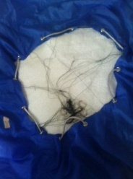
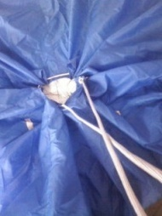
cinfirm this theory
・We use gyro and acceleration sensor to detect vibration and pressure sensor
to detect the speed.
This is the hall on the top of the parachute. When the string is pulled , the hall becomes small.

Slide 4
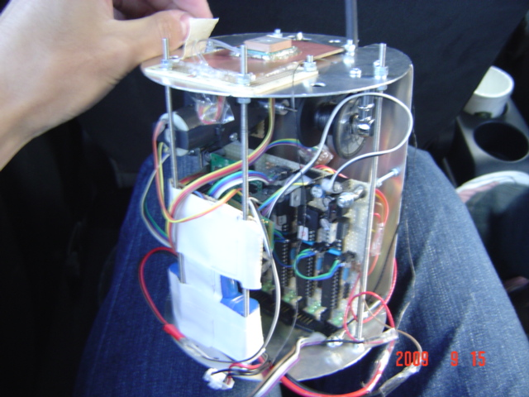
The Shape Of AeroSmith -1

Slide 5
Results
Hall is closed
The altitude data. When the hall is closed , the hall data is high.

Slide 6
Results
Altitude | The average speed
3000m~2000m | 2.94 m/s
2000m~500m | 3.27 m/s
500m~ | 0.495 m/s

Slide 7
Results
The gyro data

Slide 8
Results
The acceleration sensor data ( not including the effect of gravity)

Slide 9
Achievement
●To make air hall on the top of parachute……
・We can control the fall speed by pulling the string around the hall.
・We can remove the vibration by making the air hall
And it is very simple structure!!

Slide 10
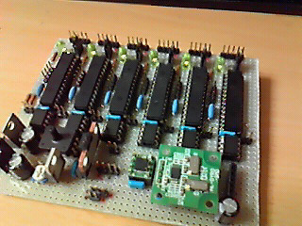
The Main Circuit

Slide 11
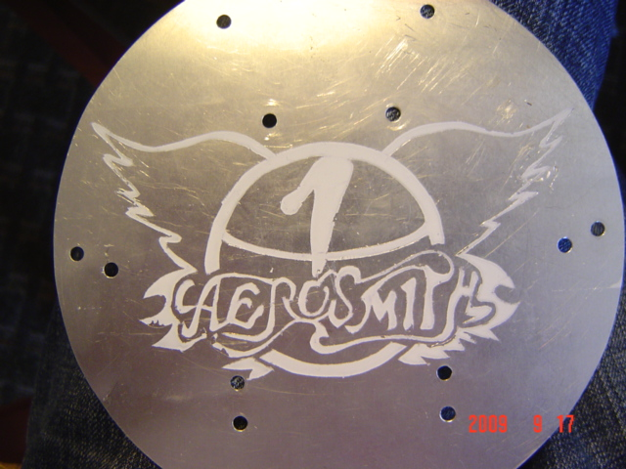
おつかれさまでした。

